Slide 1

What is Chatbot?

Slide 2
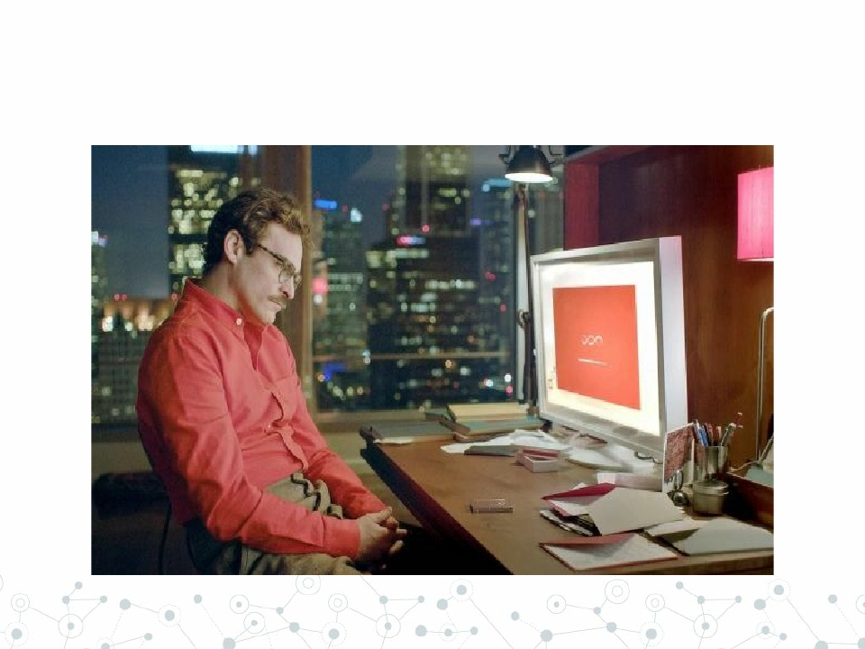

Human-level General Conversation

Slide 3
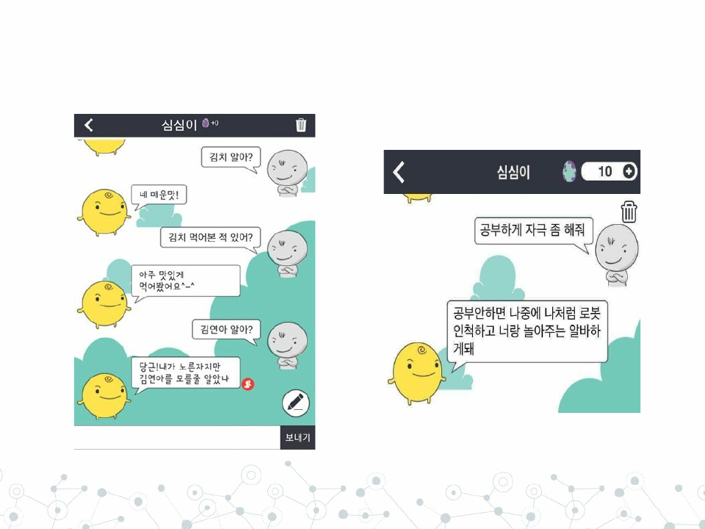
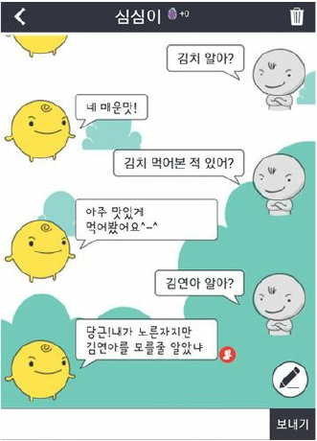
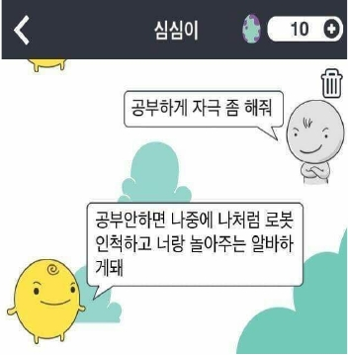
General Conversation

Slide 4
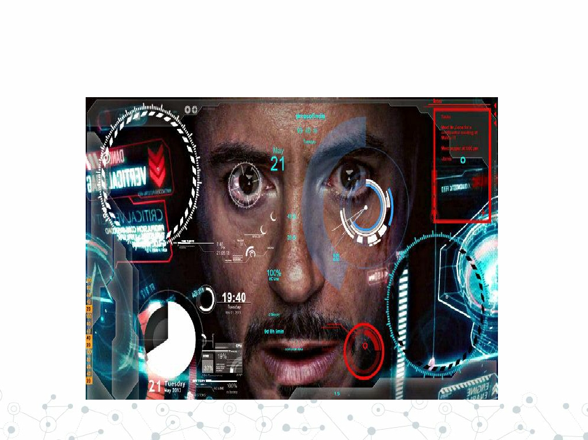
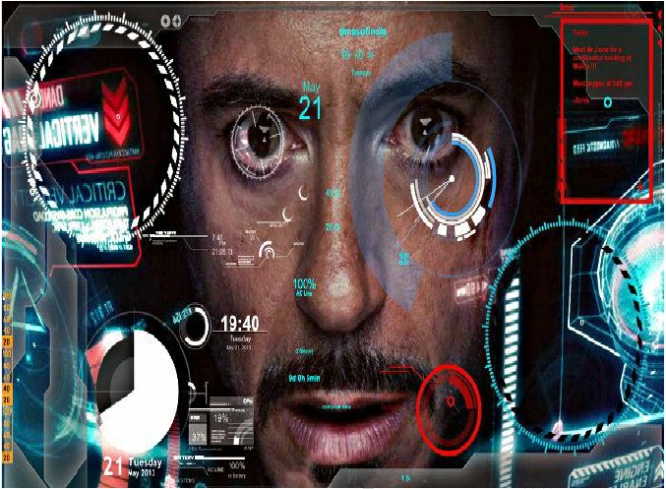
Super Smart Home API

Slide 5
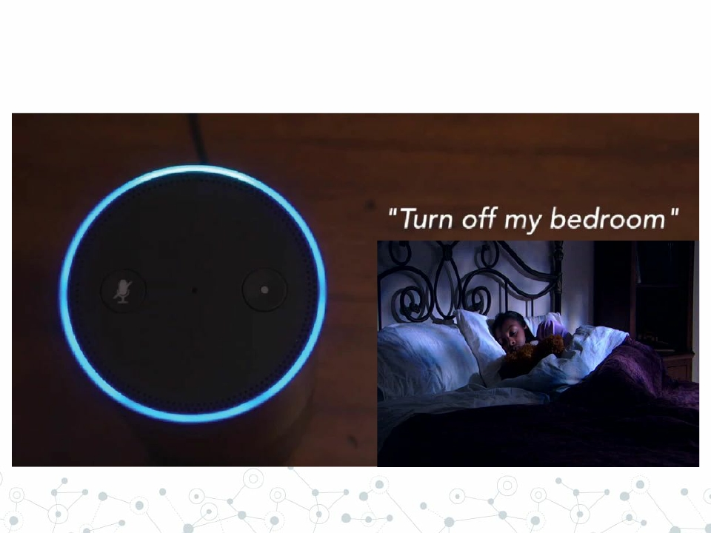
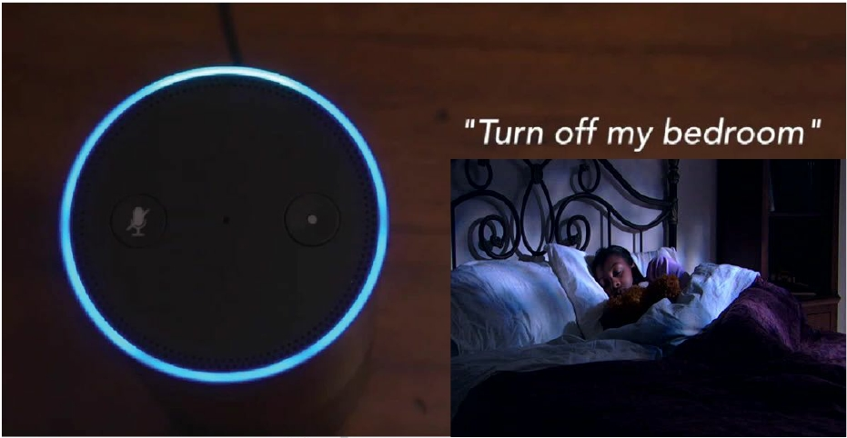
Smart Home API

Slide 6

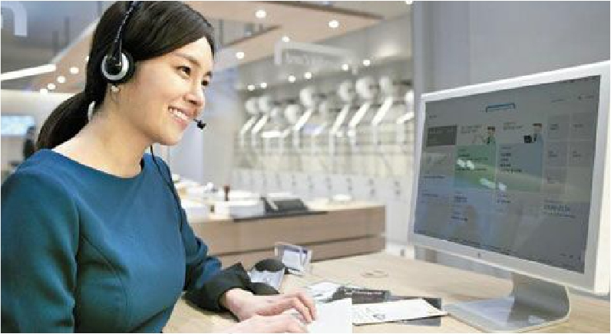
Human Customer Service

Slide 7
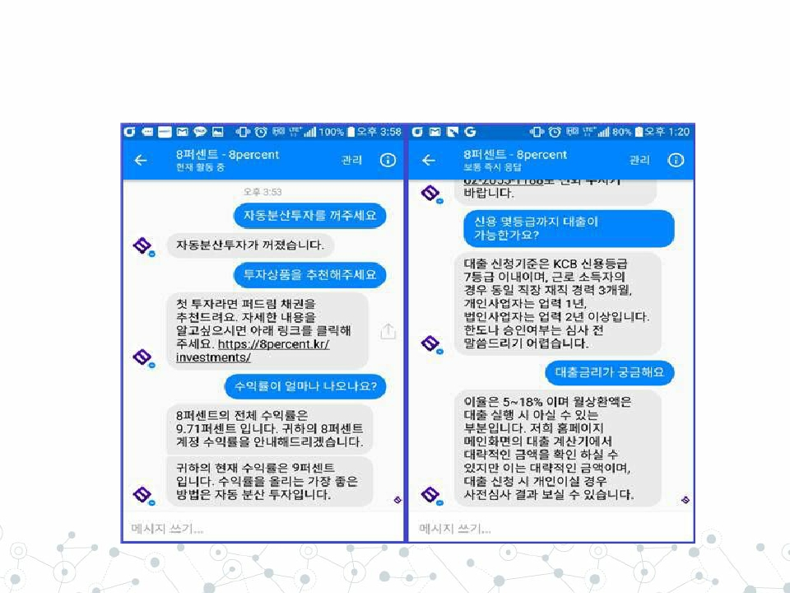
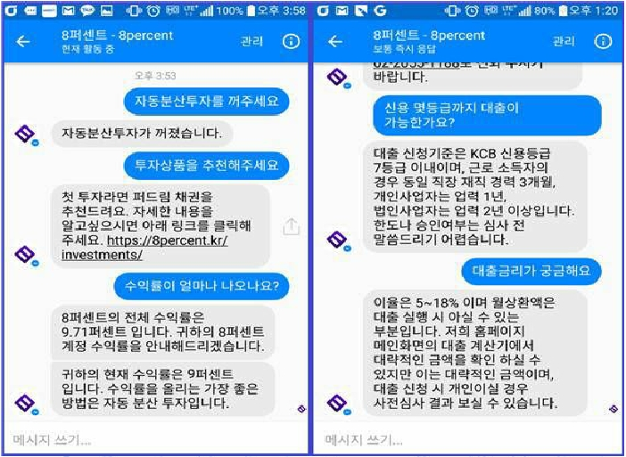
Customer Service

Slide 8
Different Goals,
Single task!
Sequence to Sequence mapping

Slide 9
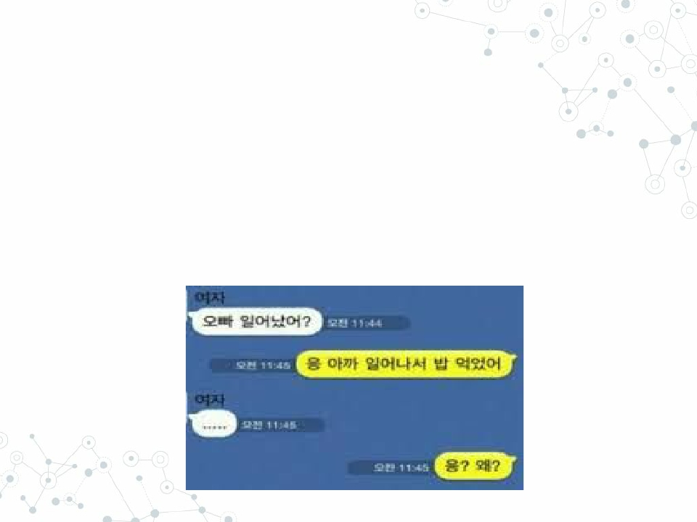
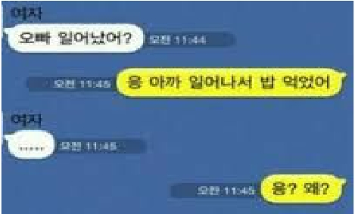
Chatbot as Sequence to Sequence mapping
◎ Just like translation
○ Hello (Eng.) => 안녕하세요 ! (Kor.)
◎ Question (+ Context) => Answer

Slide 10


Deep
Learning
Doing great jobs in
many fields!

Slide 11
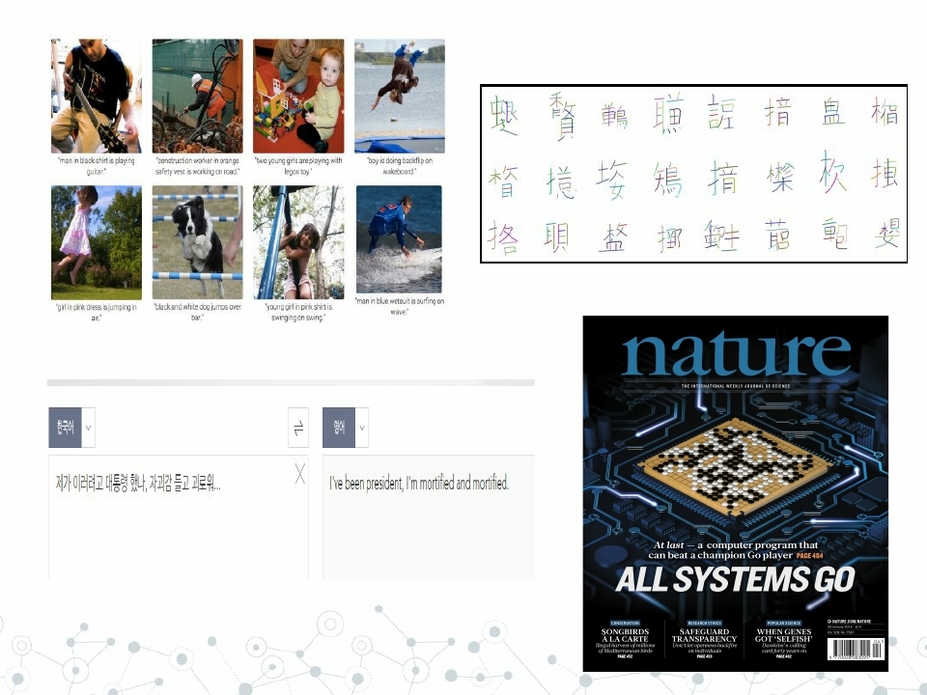
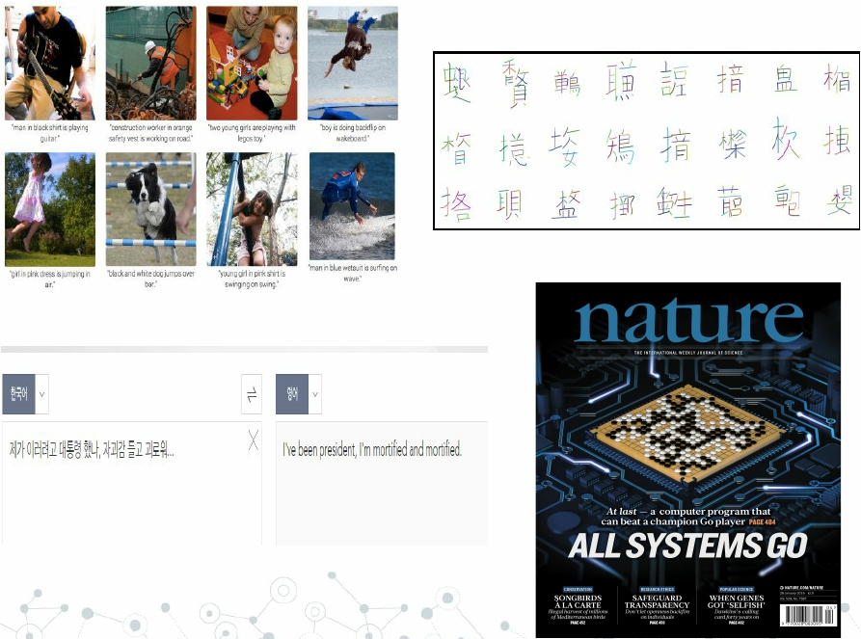

Slide 12
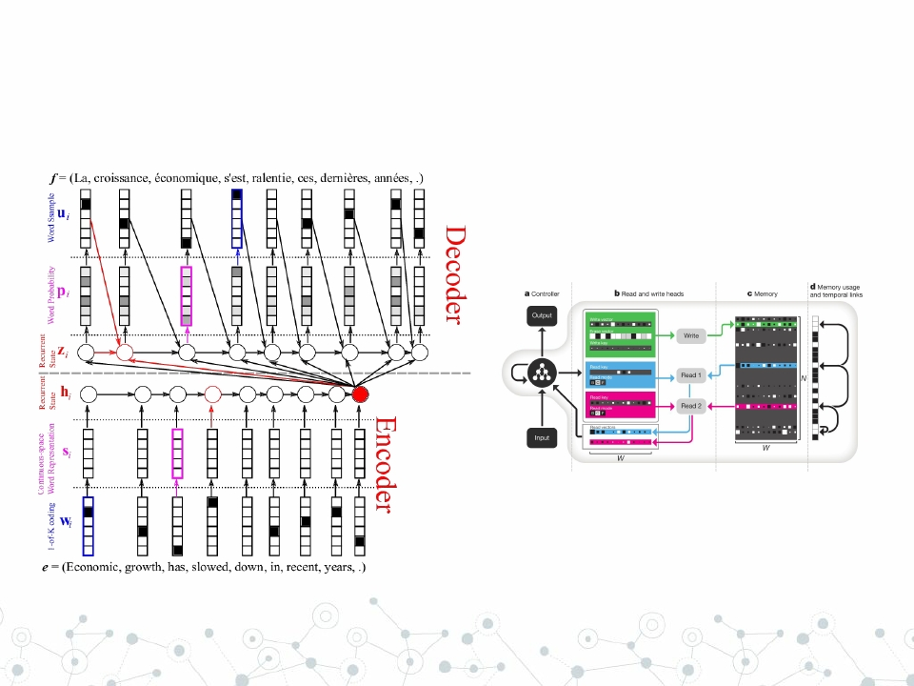
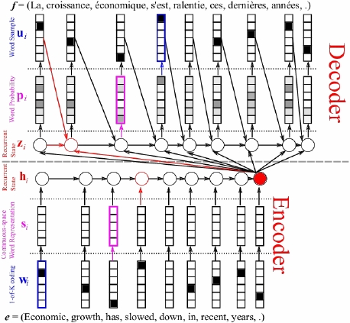
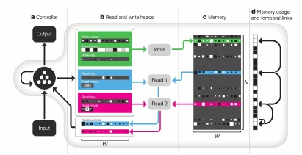
RNN Encoder-Decoder (+ attention + augmented memory)

Slide 13
That looks Coooool!
Where is my J.A.R.V.I.S.?

Slide 14
Of course,
You can make deep learning bots.
However, purely generative bot say random words.
Because they don’t understand what they are talking about.

Slide 15


Words and understanding
◎ Words
○ Words / characters are symbols
○ A Language is already a function
◉ f : thought/concept -> word
f 1 = Korean
f 2 = English
사과
Apple
○ Words are already result of learning
◉
Not like R G B image channels
○ Element of Natural Language Graph Model

Slide 16
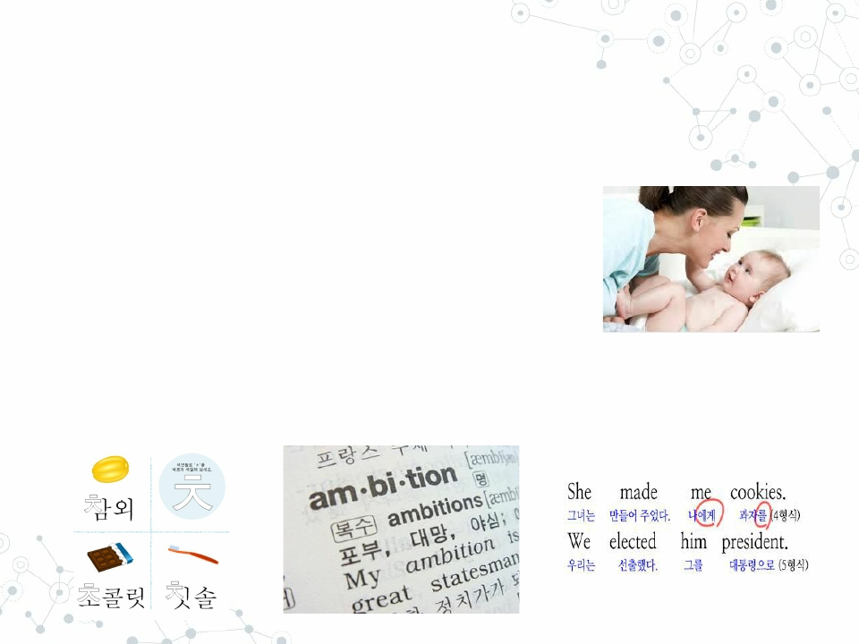
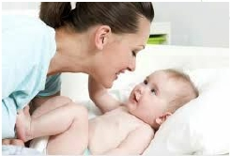
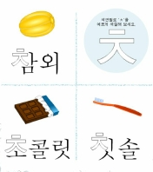
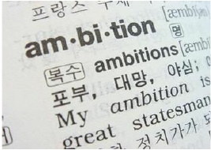
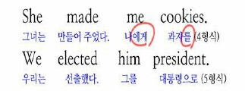
Words and understanding
◎ When learning a new word
○ Mimic others’ usage
◉ Indirectly learn by examples
○ Grammar / Dictionaries
◉ Directly learn Knowledge Structure
◉ Transfer learning

Slide 17
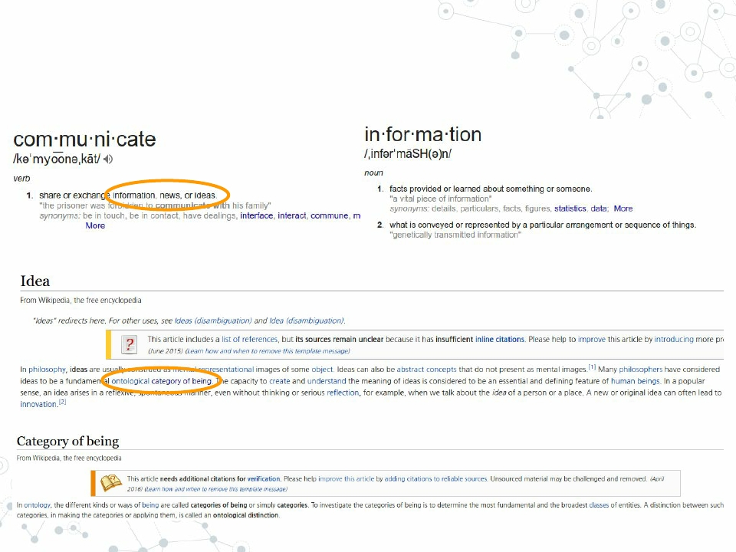
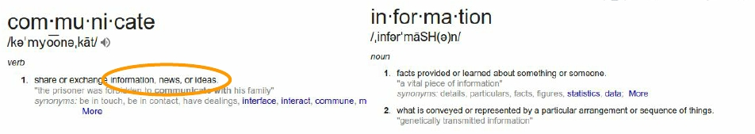
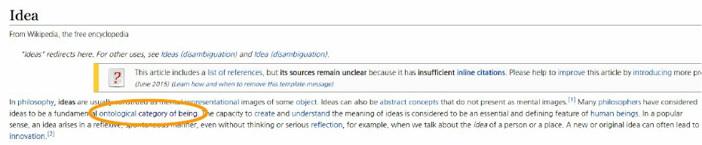
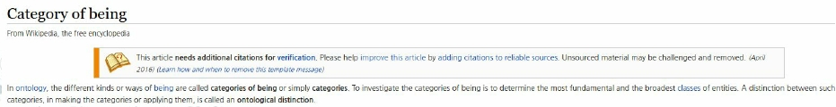
Words and understanding

Slide 18
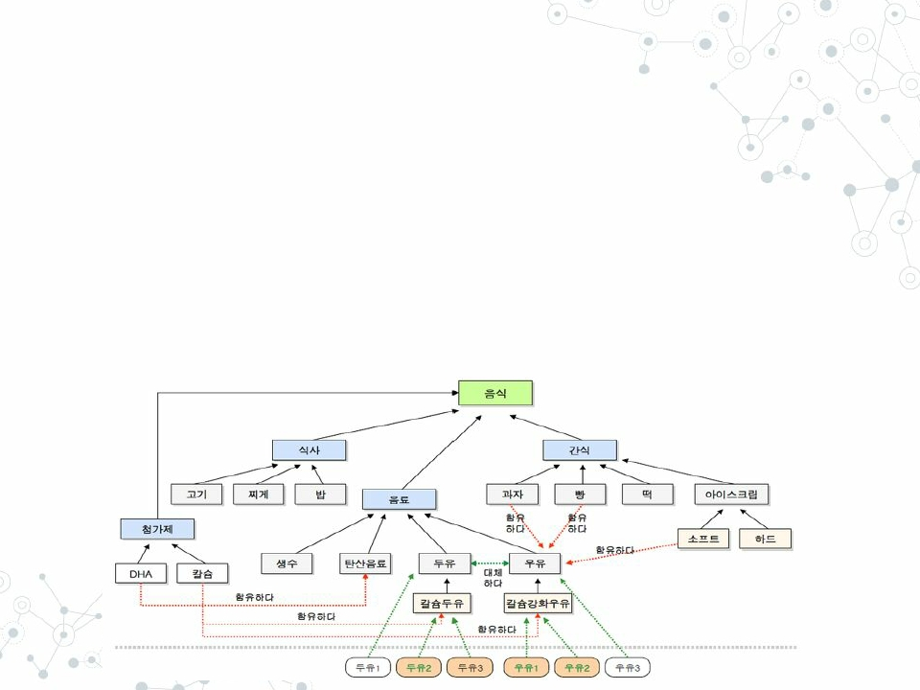
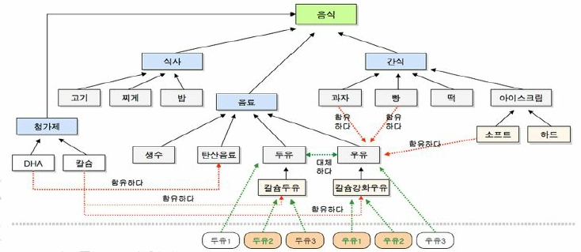
Words and understanding
◎ We use languages
○ To communicate
○ To successfully express information/idea
◉ Requires to represent prior knowledge
◉ Ex. Ontology (Entity - Properties - Relationships)

Slide 19

Words and understanding
◎ Understanding a new concept requires
○ Prior knowledge
◉ Relationships between existing concepts
○ Operations
◉ Scoring / Comparing similarities
◉ Identifying nearest concept
◉ Updating existing informations
◉ Creating / Deleting concepts / connections

Slide 20
Human vs Neural Networks
Human Brain
# of synapses > 10¹⁴
Neural Networks
# of synapses < 10¹⁰
To maintain Human-level conversations,
AI should understand meaning of sentence.
Memory structure / DB management
Human Brain >>>>>> 넘사벽 >>>>> Neural Networks

Slide 21
Deep Learning cannot understand what you mean
Even state-of-the-art models are still not structured enough to
successfully represent languages and prior knowledges

Slide 22
If you still want to build your own
Deep Learning chatbots..!
◎ WildML(Denny Britz)’s Blog Post
◉
◉
◉
◉
RNN Retrieval model
Dual Encoder LSTM
Trained on Ubuntu Q&A Corpus
Sourcecode provided
◎ Jungkyu Shin’s 미소녀봇
◉
◉
◉
◉
RNN Generative model
Trained on Japanese anime subtitles
Good Explanation of overall architecture of bot
no sourcecode provided

Slide 23
So.. now what?

Slide 24
Why do you want to build bots?

Slide 25
Bots for business / Conversational AI
Business
Topic
- narrow
Tasks
- Domain-specific
- Relatively Small in number
Important
- To provide information
- And NOT to make mistakes
Friend
Topic
- broad
Tasks
- General & and abstract
- Numerous
Important
- To maintain natural dialogue
- And make it pleasant

Slide 26
Today, I’ll talk about
Bots for business!

Slide 27

More specifically..
Intent Schema /
Architecture
Corpus
Feature
engineering
NLP / NLU Tools
Classification /
Generation algorithms
And some more! (DM, OOV …)

Slide 28
Focus on a few intents!
Divide-and-Conquer

Slide 29
Intent Schema
◎ For Business bots, some questions are
more important than others
○ Don’t need to deal with everyday conversations
○ Focus on small number of topics and tasks, which
are more important in business
◎ Hierarchical Intent schema
○ 1) Classify questions into intents
◉ Business / Non-Business
○ 2) Generate responses differently at each intent
◉ Focus more on important intents
○ Easier to debug / monitor

Slide 30
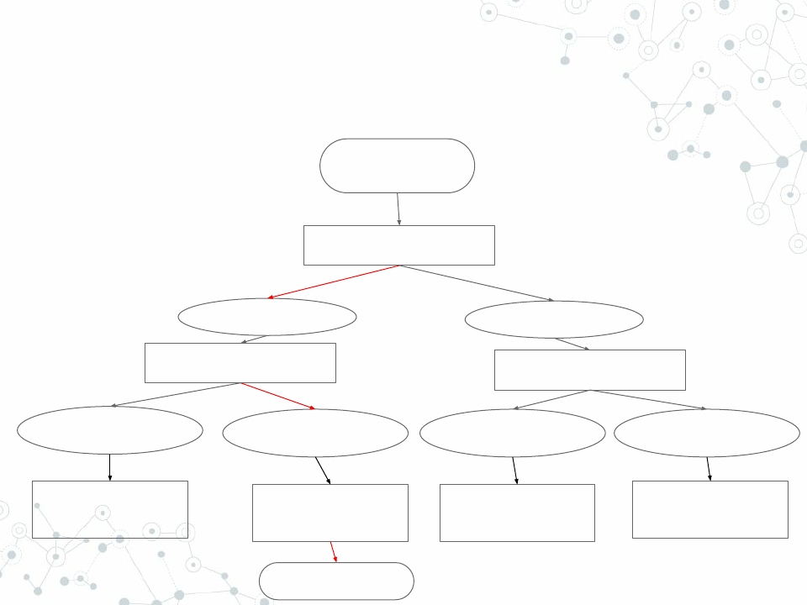
Hierarchical Intent Schema
Sentence
Level-1 Classifier
Business Intent
Level-2 Classifier 1
Non-Business
Level-2 Classifier 2
Business Intent
1
Generation Module
1
Business Intent
2
Generation Module
2
Non-Business
Intent 1
Generation Module
3
Non-Business
Intent 2
Generation Module
4
Response

Slide 31
Architecture
End-to-End vs Modularization

Slide 32
Architecture
◎ End-to-end model is (academically) fancier
◎ However, Deep Learning is Black Box
○ Hard to understand reasoning pattern
◎ Modularization gives you
○ Easier debugging
○ Flexibility
○ Accountability

Slide 33
Architecture
◎ Core modules
○ Sentence vectorizer
○ Intent classifier
○ Response generator
◎ Optional
○ Tone generation
○ Error correction

Slide 34

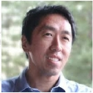
What data can / should we
use?
“Among leading AI teams, many can likely replicate others’ software in, at most, 1–2 years. But it
is exceedingly difficult to get access to someone else’s data. Thus data , rather than software, is
the defensible barrier for many businesses.”
Andrew Ng , “What Artificial Intelligence Can and Can’t Do Right Now”, Harvard Business Review

Slide 35
Corpus
◎ Open Corpora
○
○
○
○
○
General topics
Old, mostly written language
Sejong / KAIST Corpus
Namu Wiki dump / Wikipedia dump
Naver sentiment movie corpus
◎ Web scraping
○ You can configure what you scrap
◉ General or domain specific
○ colloquial language, newly coined words
○ SNS - Facebook, Twitter
○ Online forums, blogs, cafes

Slide 36
Corpus
◎ None of these provide perfectly fit
domain-specific Q&A
◎ You should make sure that
you (will) have enough chat data
Before you start bot business

Slide 37
How to vectorize a sentence?

Slide 38
Hierarchical Intent Schema
Sentence
Level-1 Classifier
Business Intent
Level-2 Classifier 1
Non-Business
Level-2 Classifier 2
Business Intent
1
Generation Module
1
Business Intent
2
Generation Module
2
Non-Business
Intent 1
Generation Module
3
Non-Business
Intent 2
Generation Module
4
Response

Slide 39
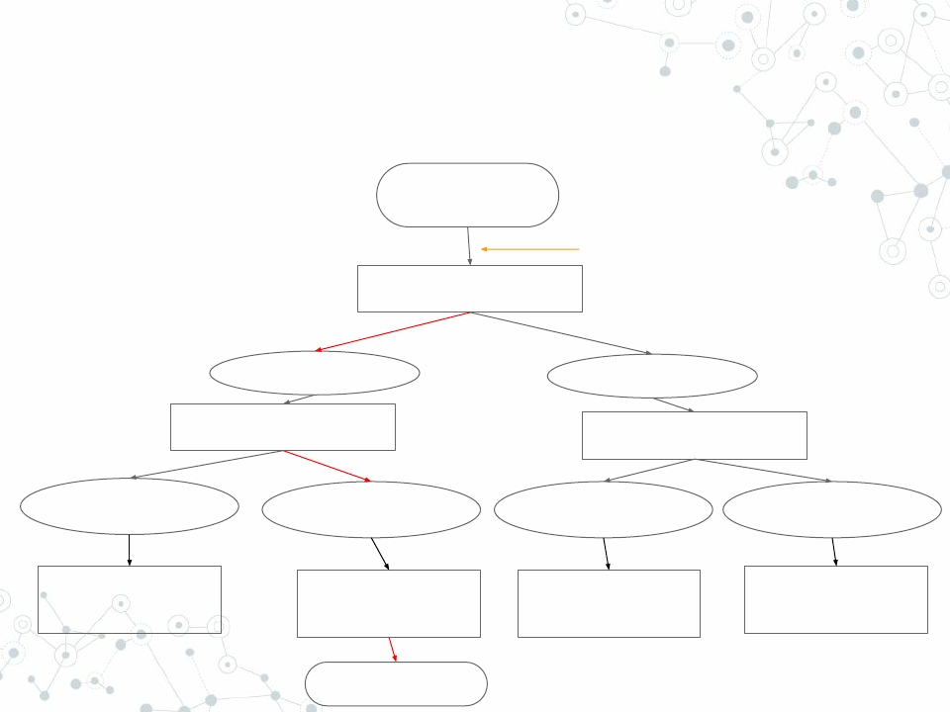
Hierarchical Intent Schema
Sentence
Sentence Vectorizer
Level-1 Classifier
Business Intent
Level-2 Classifier 1
Non-Business
Level-2 Classifier 2
Business Intent
1
Generation Module
1
Business Intent
2
Generation Module
2
Non-Business
Intent 1
Generation Module
3
Non-Business
Intent 2
Generation Module
4
Response

Slide 40
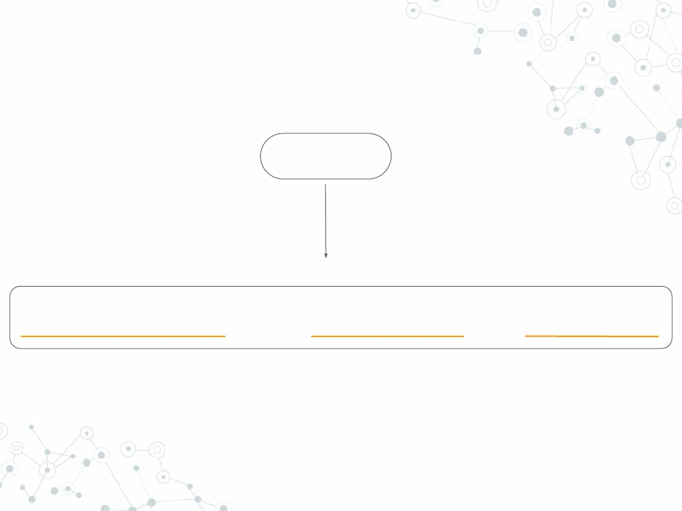
Sentence vectorization
Sentence
0.25, 0.5, -0.41, 0.30, -0.12, 0.65, ……………… , 0, 0, 0, 2, 0, 0, 0, 3, 0, 0, ………… , 0.24, 0.35, 0 ,1, 1, 1
Word Embeddings
Keywords
Custom Features

Slide 41
Feature Engineering
◎ Sentence as sequence of words
○ Get word embeddings
◉ CBOW / Skip-grams
◉ Gensim / fastText
○ How to combine words?
◉ Sum / Average
◉ Concatenate
●
padding required for fixed-length vector
◉ RNTN / Tree-LSTM
●
robust for long sentences / Parser required

Slide 42
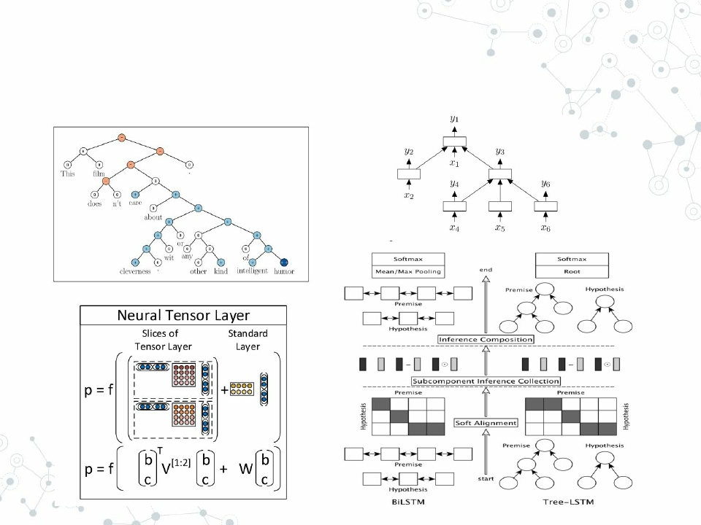
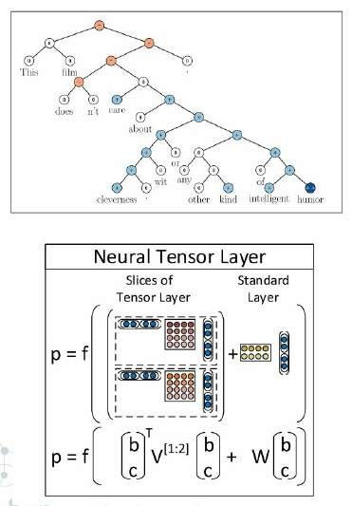
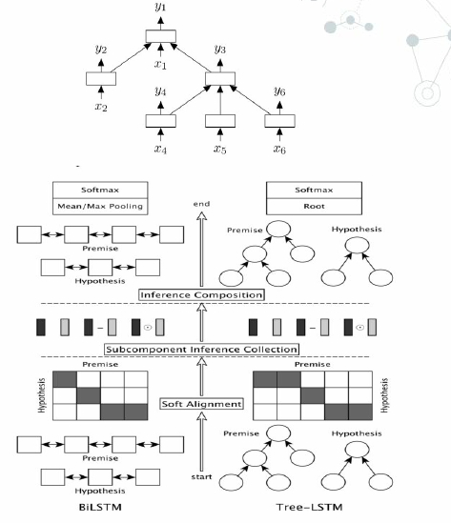
RNTN / Tree-LSTM

Slide 43
Feature Engineering
◎ Character-level embedding
○ Information loss during word normalization
◉ Tense, singular/plural, sex ...
◉ Even meaning can be affected
○ C2W
◉ Char embedding + cached word embedding
◎ Directly generate sentence vector
○ Doc2Vec (paragraph vec)
○ Skip-thought vectors

Slide 44
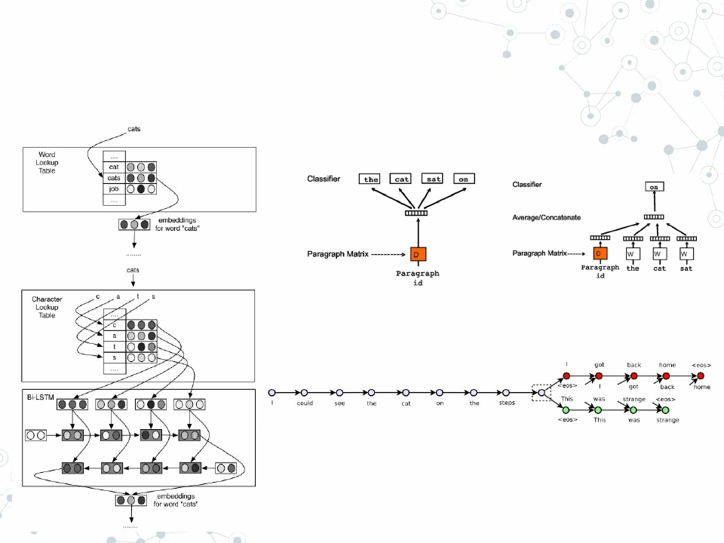
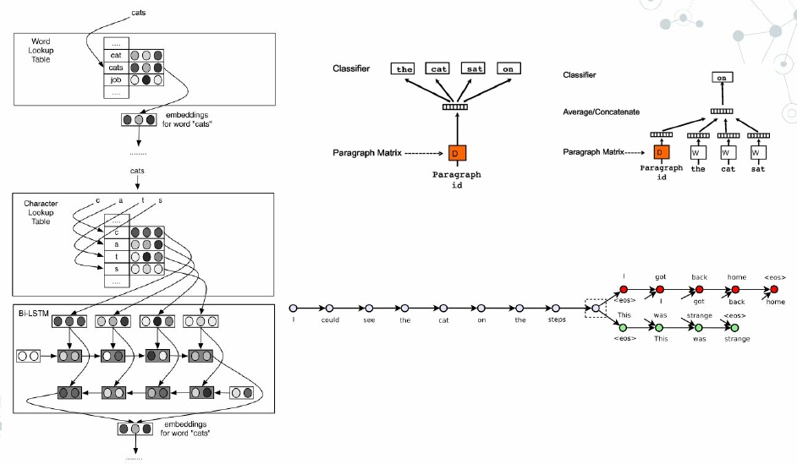
C2W / Doc2Vec / Skip-thoughts

Slide 45
Feature Engineering
◎ Word sense disambiguation (WSD)
○ homonyms and polysemous words
○ POS embedding
◉ Get embedding after auto-tagging the corpus
◉ Ex. v( 사과 /Noun) ≠ v( 사과 /Verb)
◎ Space information
○
○
○
○
Sentence = words + spaces
Space information loss during tokenization
Prefix, suffix padding with special character
Space as a word

Slide 46
Feature Engineering
◎ Co-occurrence is not almighty
○
○
○
○
Only captures syntax
Can’t capture meaning
Ex1. v(Football) ≒ v(Baseball)
Ex2. v(Loan) ≒ v(Investment)
◎ Need something more than co-occurrence!

Slide 47
Feature Engineering
◎ Keyword Occurrences
○ Top K most frequent words from your own data
○ Keyword Occurrence vector of length K
◎ And some more...
○
○
○
○
○
POS Tagger, Parser, NE Tagger
Word n-grams, Character n-grams (subwords)
Reverse word order ( ≒ Bi-RNN)
Length of query
Non-language data
◉ Location / Time
◉ Private info.
●
Purchase history / Customer type / etc.

Slide 48
NLP/NLU Tools
◎ Goal
○ Information gain in sentence vectorization
○ If accuracy decreases => Not worth it!
◎ Existing tools (Ex. Taggers of KoNLPy)
○ Trained with general, written language (Sejong /
Wikipedia)
○ Cannot process
◉ Colloquial styles
◉ newly-coined words
◉ domain-specific expression
○ Train your tool with your own corpus !

Slide 49
NLP/NLU Tools
◎ POS tagger
○ 조사 helps semantic role labeling (SRL)
◉ 주격조사 => 주어 , 목적격조사 => 목적어
○ Word Normalization
○ Mecab-ko , Twitter , Komoran (3.0)..
○ Rouzeta (FST)
◎ Parser
○ Head information, Phrase tag
○ Korean vs English
◉ Dependency parser might work better for Korean
○ dparser / SyntaxNet

Slide 50
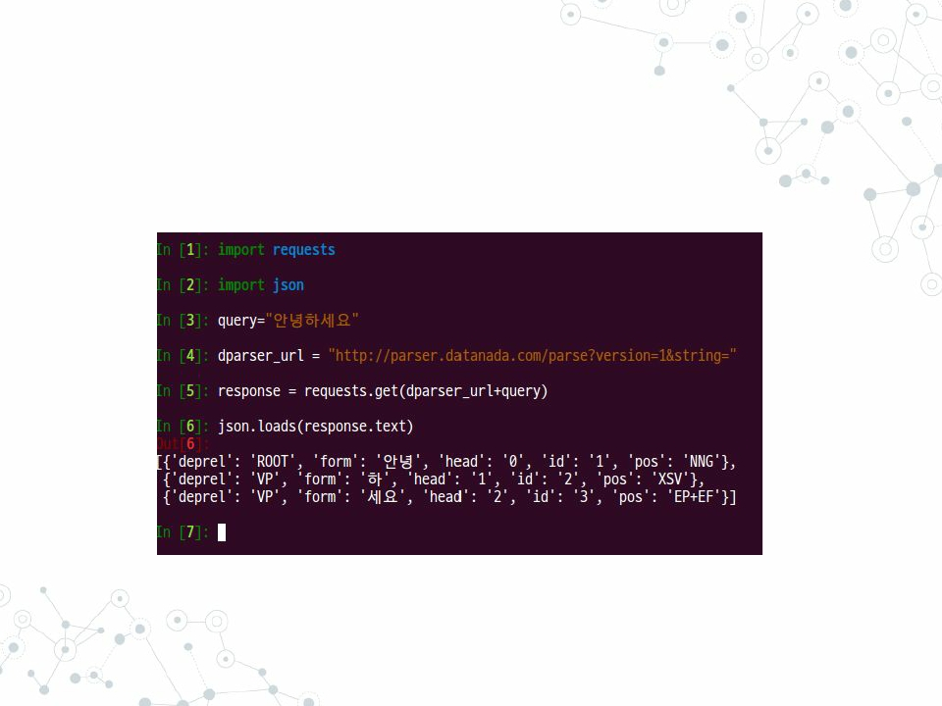
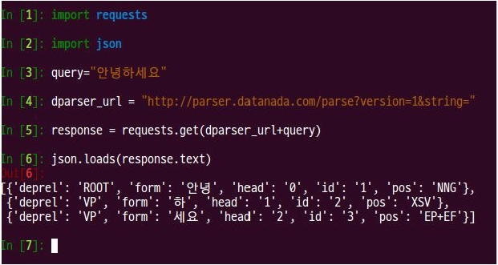
NLP/NLU Tools

Slide 51
NLP/NLU Tools
◎ NE tagger
○ annie (CRF + SVM)
◉ Not the best, but the only open-source Korean NE tagger
○ Tagger (Bi-LSTM + CRF / Theano)
◉ Trained with English
◉ IOB format
○ 2016 국립국어원 국어정보경진대회 - NER
◎ 국립국어원 국어정보경진대회
○ The only annual competition for Korean NLP

Slide 52
NLP/NLU Tools
◎ Helpful for those who don’t have enough
time to develop own tools!
◎ Make sure you understand how they work!
○
○
○
○
Again, they are trained with general corpora
Maybe enough for toy academic usage
But not enough for business
You should be able to
◉ Train with your own data
◉ Tweak parameters (and model itself)!

Slide 53
NLP/NLU Tools
◎ Sequence Labeling
○ POS-Tagging, Parsing, NE-Tagging, Spacer
◎ Data Format
○
○
○
○
IOB
PTB
CoNLL-U
Sejong
◎ Algorithms
○ PGM: CRF
○ Neural Networks: RNN
○ Hybrid: LSTM-CRF

Slide 54
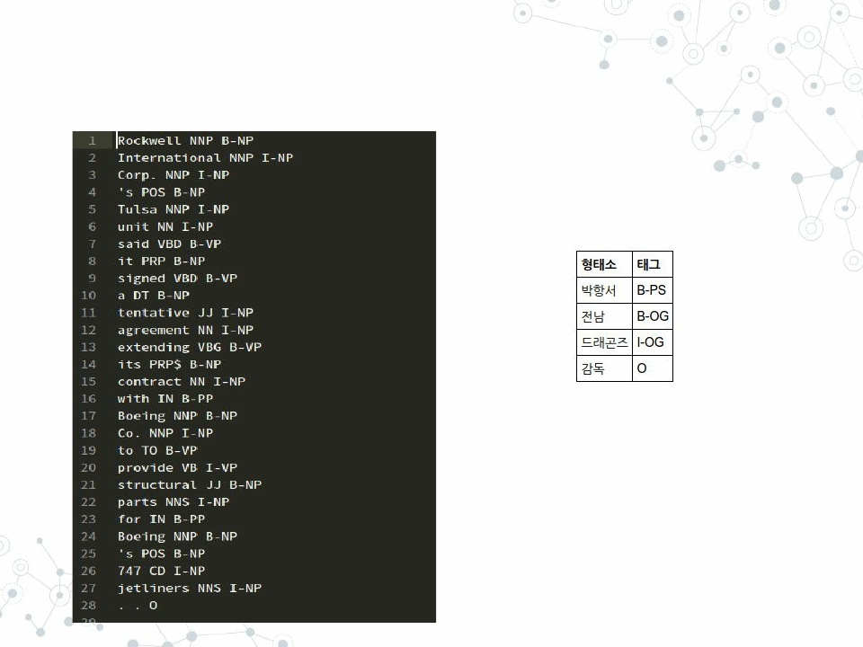
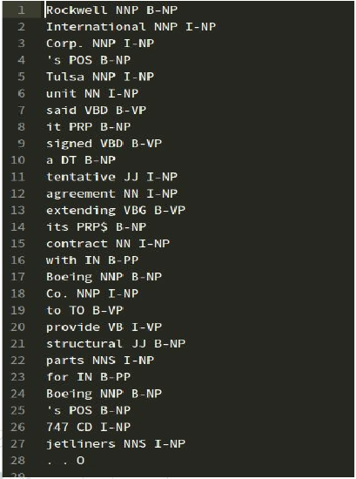
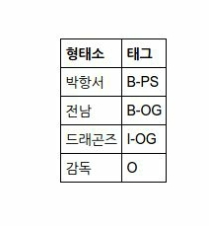
IOB

Slide 55
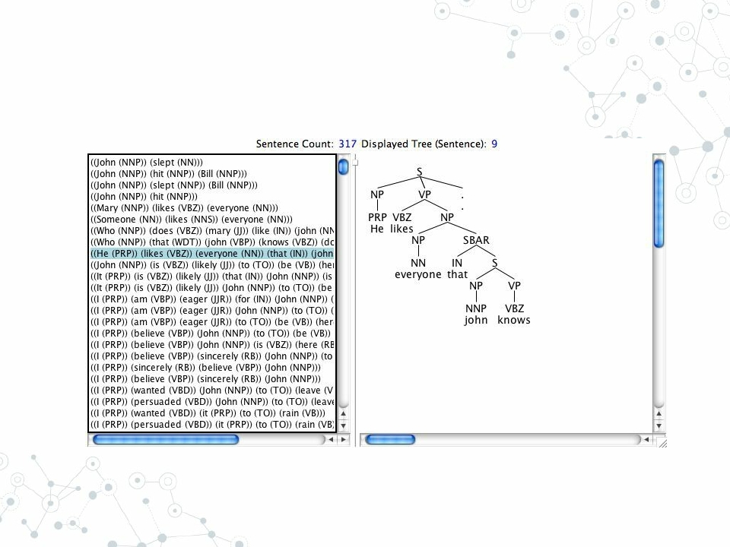
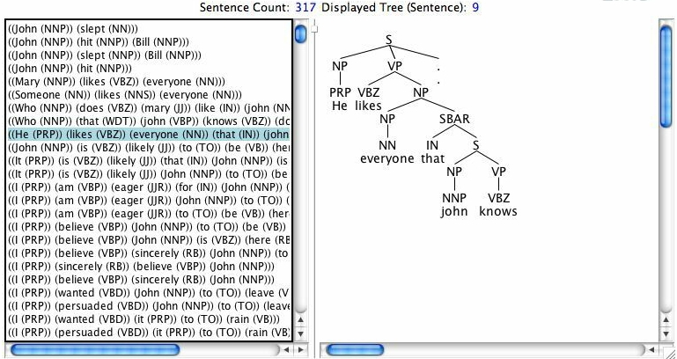
PTB

Slide 56
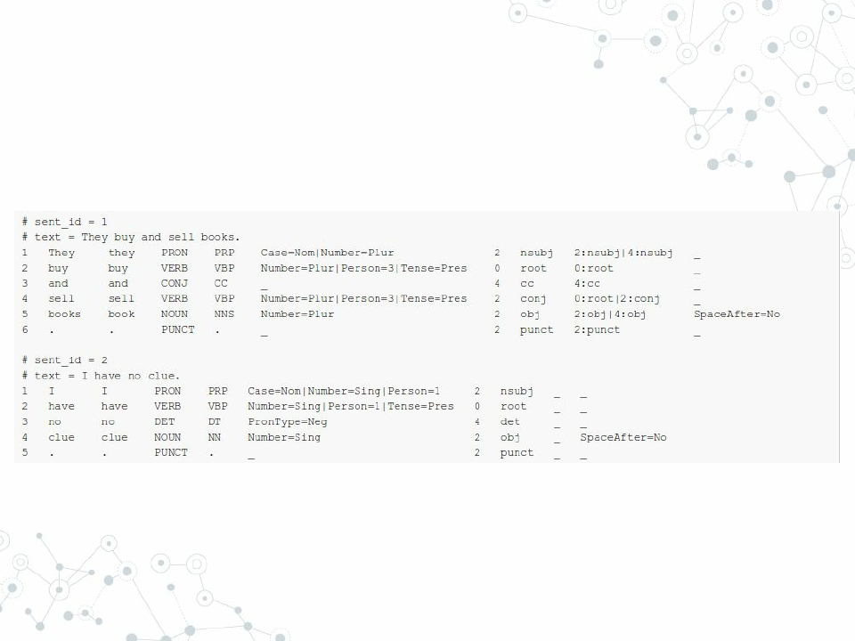
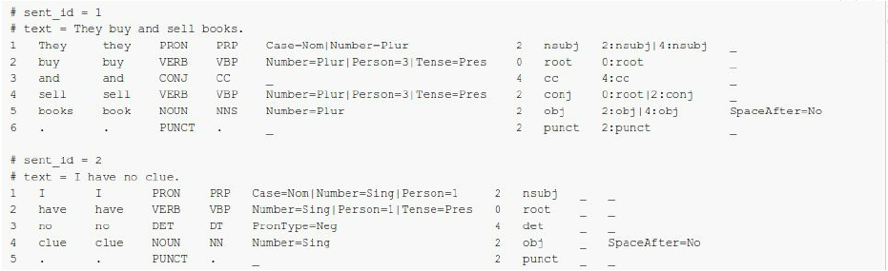
CoNLL-U (Universal Dependencies)

Slide 57
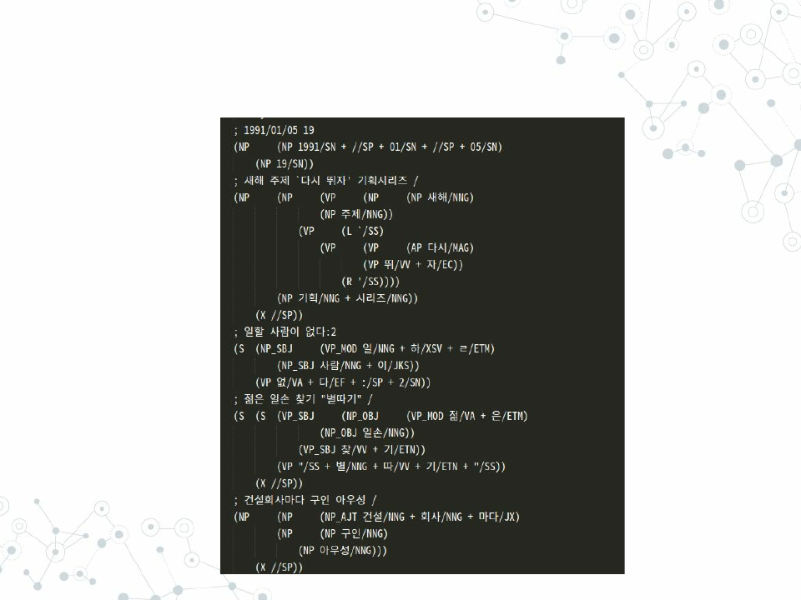
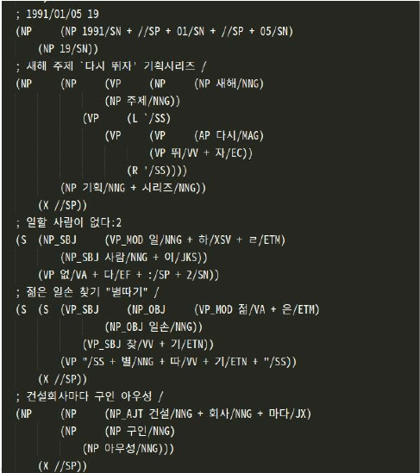
Sejong Treebank

Slide 58
Classification / Generation algorithms
◎ Classification
○ SVM
◉ Scikit-Learn
○ Decision Trees (Random Forest / Gradient Boosting)
◉ Scikit-Learn / Xgboost / LightGBM
○ Linear Models
◉ fastText
○ Neural Networks (CNN / RNN)
◉ TensorFlow / Theano
◉ Try simple implementation first! (tf.contrib /
Keras)
◉ likejazz’s cnn-text-classification-tf
◉ Requires HUGE data

Slide 59
Classification / Generation algorithms
◎ Generation
○ Predefined answers
◉ Randomly select a response from ‘response list’
◉ Slot filling
●
response = “Hello { customer_name }!”.format( customer_name = customer_name )
○ Neural models
◉ Seq2Seq + attention + augmented memory
◉ Copying + Two step (Latent Predictor Networks)
◉ Dual Encoder, HRED
◉ Beam Search
◉ Easy seq2seq / OpenNMT
◉ Need Huge data
◉ Check out QA competitions
●
SQuAD leaderboards

Slide 60
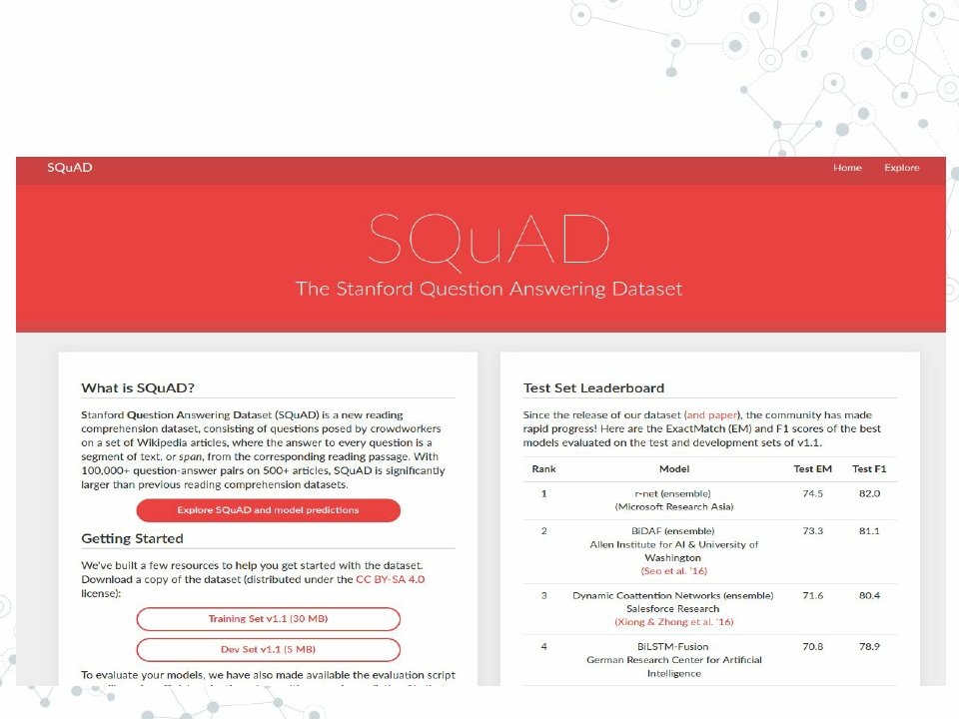

SQuAD Leaderboards
◎

Slide 61
Classification / Generation algorithms
◎ Executed every time processing query
◎ Critical to response time
○ These can take time > 1 sec
◉ import tensorflow as tf
◉ load( ‘./model.pkl’ )
○ Pre-load
○ Caching

Slide 62
ML modules to train
◎ Sentence Vectorizer
○ Word/Character/POS embedding
○ Word vector concatenating operator
○ extra features to capture meaning
◎
◎
◎
◎
Intent Classifier
Response Generator
POS tagger / Parser / NE Tagger
(Optional)
○ Tone generator
○ Error Corrector
◉ Typo / Grammar / Space ( 띄어쓰기 )

Slide 63
Non-ML modules to prepare
◎ Predefined answers
○ List of answers to be randomly selected
○ Answers with unique entity slots to be filled
◎ DB Integration
○ Update chat history to training data
◎ Web Scraper
○ HTML / XML / JSON parsing
◎ Format converter
○ Open source data have different formats
○ PTB / CoNLL / IOB …
◎ Server

Slide 64
Optional, but highly recommended to equip
◎ Data Admin / Input panel
○ Easy Overview / Edit
○ Mechanical Turk
◎ Custom Dictionary
○ Domain-specific expressions
○ Integration with existing tools / DB
◎ Scorer for each module
○ One Click cross validation / test
◉ Crucial with small data / complicated architecture
◎ Visualization
○ Performance overview
○ Confusion matrix
○ T-SNE for sentence vectors

Slide 65
Let’s go a little further!
Two tricky problems: DM and OOV

Slide 66
Dialogue Management
◎ Finite State scenario
◎ Markov Decision Process

Slide 67
Dialogue Management - Finite State-based Scenarios
◎ Hand-crafted by dialogue experts
◎ Predetermined Scenario
◎ Pros.
○ Simple model
○ Natural way to deal with well-structured tasks
○ Information exchange is tractable
◎ Cons.
○ Inflexible
◉ Customers should follow predefined flow
○ Low maintainability
◉ different scenarios as system gets bigger

Slide 68


Dialogue Management - Finite State-based Scenarios

Slide 69
Dialogue Management - Markov Decision Process
◎ State transition problem
○ State: high level context
○ Action: To choose next context
○ Agent: Bot
◎ Deep RL
○ Imitation / Forward Prediction / HRED
◎ Not suitable for business yet
○ No universal reward function / evaluation metric
○ Requires huge labeled dialogue data
○ Top papers are still solving toy problems
◉ accuracy < 50% or # of action < 10

Slide 70


Dialogue Management - Markov Decision Process

Slide 71
Dialogue Management - Markov Decision Process
◎ Very Interesting & maybe right way to go
○ But cannot cover in 2 mins ㅜㅜ
○ NLP / DL / RL + a
◎ Reading lists
◎
◎
◎
◎
◎
◎
◎
◎
Spoken Dialogue Management Using Probabilistic Reasoning (2000)
Optimizing Dialogue Management with Reinforcement Learning : Experiments with the NJFun System (2000)
A Hierarchical Recurrent Encoder-Decoder for Generative Context-Aware Query Suggestion (2015)
Strategic Dialogue Management via Deep Reinforcement Learning (2015)
Continuously Learning Neural Dialogue Management (2016)
How NOT To Evaluate Your Dialogue System: An Empirical Study of Unsupervised Evaluation Metrics for Dialogue
Response Generation (2017)
Dialogue Learning with Human-In-The-Loop (2017)
End-to-End Joint Learning of Natural Language Understanding and Dialogue Manager (2017)

Slide 72
Out-of-Vocabulary Words
◎ Replace with the most similar word
○ Dictionary / WordNet
○ Web search
◉ Naver / Wikipedia / Namuwiki
◉ Select top k articles
◉ POS-Tagging and get the most frequent word
◎ Get word embedding with subword information
○ C2W
○ fastText
◉ Not compatible with Gensim

Slide 73
Should we really develop
all of these?
There are 100+ bot builders...

Slide 74



Slide 75
Bot builders
◎ Bot builders provide many tools
○
○
○
○
NLU engines
DB management
GUI Interface
Serving with different platforms
◎ You have to pay for the service
◎ You cannot customize modules / architectures

Slide 76
More importantly,
Are bots worth to develop?
Can they actually replace
human worker / websites / apps ?

Slide 77
Bots are too hyped!
◎ Inefficient to existing platforms
○ # of inputs / response time
○ Many big companies develop bots for
◉ Promotion / Branding
◉ Part of long-term AI Research
◎ Assistance instead of replacement
○ Handle simple queries only
◉ Pass dialogue to human if confidence is low
○ GUI customer service advisor
◉ Like Smart Reply

Slide 78
Let’s share our knowledge
◎ Let’s not reinvent wheels!
○ Tons of Dataset/algorithms have been published in
journals, but not open-sourced
◎ Data / Algorithm sharing will flourish Korean
NLP ecosystem

